Slide 1

Blueprint for Multi-Engine DBaaS
A Practical, Scalable, Multi-Engine Database-as-a-Service Architecture
September 24, 2025

Slide 2
Agenda
DBaaS Overview and Engines Glue & Data Plane Integration Control Plane and Orchestration Observability and Operations Tenancy Model and Plans High-Level Architecture Scaling Models per Engine Kafka as Integration Glue Plans and SLAs Security and Compliance Highlights

Slide 3


DBaaS Overview & Engines
Overview
Focus on the unique capabilities of each engine to highlight the platform’s versatility for different workload needs.
DBaaS Concept
YugabyteDB
A Database-as-a-Service platform providing managed, scalable, and highly available database engines across regions with seamless orchestration and tenant isolation.
Distributed SQL with PostgreSQL compatibility, supporting global tables and native cross-region replication for OLTP workloads.
Vitess (MySQL)
ScyllaDB
DragonflyDB & Others
Horizontally sharded MySQL with transparent query routing and cross-region read replicas for scalable web applications.
Cassandra-compatible, shard-per-core architecture designed for low-latency writes and multi-data-center replication.
DragonflyDB offers ultra-fast Redis/Memcached APIs with active-active clustering; Aerospike provides strongly consistent high-TPS key-value storage; MongoDB supports sharding and replica sets with external management allowed.

Slide 4



Glue & Data Plane Integration
Integration
Apache Kafka as the Event Backbone
Kafka streams change-data-capture (CDC) events from all DB engines, providing a unified, scalable platform for asynchronous data replication and pipeline orchestration.
Kafka Connect & Debezium
Connectors like Debezium capture CDC from PostgreSQL/Yugabyte, MySQL/Vitess, and MongoDB, while custom connectors support ScyllaDB, Aerospike, and Redis/Dragonfly streams.
Highlight Kafka's role as a central integration layer connecting diverse databases and enabling complex, real-time data workflows for your DBaaS.
Cross-Engine Pipelines & Use Cases
Kafka enables cross-engine sync, audit trails, BI lake ingestion, cache refresh, and webhook event delivery, bridging database silos with real-time event-driven architectures.

Slide 5
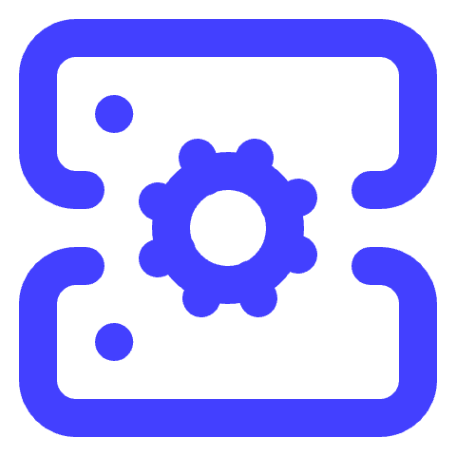


Control Plane & Orchestration
Orchestration
Kubernetes with Rancher
Database Operators
Ansible AWX Automation
GitOps with Argo CD
Rancher manages multiple Kubernetes clusters across PoPs, enabling centralized fleet management, multi-cluster RBAC, and streamlined workload orchestration for DBaaS components.
Operators for each database engine automate deployment, scaling, upgrades, and failover, leveraging native Kubernetes APIs to ensure consistent lifecycle management.
Ansible AWX handles Day-2 operations including OS hardening, node imaging, cluster bootstrap, kernel tuning, and rolling upgrades to maintain cluster health and security.
GitOps tools like Argo CD enable declarative environment provisioning, continuous deployment, and version-controlled infrastructure through Git repositories.
Customize this slide by adding specific examples of automation workflows and tools your team uses in orchestration and Day-2 operations.

Slide 6



Observability & Operations
Observability
Customize this slide by adding examples of tenant-specific dashboards or alerts relevant to your DBaaS environment to engage your audience.
Monitoring with Prometheus & Grafana
Prometheus collects metrics from all DB engines and Kubernetes components, storing them long-term with Mimir/Thanos. Grafana provides customizable dashboards per engine and tenant for real-time visibility.
Logging & Tracing
Loki aggregates logs from all services including database audit logs, while Tempo collects distributed traces enabling detailed slow query and transaction analysis across the platform.
OpenTelemetry & Optional Tools
OpenTelemetry collectors standardize telemetry data ingestion. Optional tools like Zabbix and OpenNMS offer network and SLA monitoring to complement core observability and enforce SLO guardrails with Alertmanager.

Slide 7
Tenancy Model & Plans
Tenancy
01
02
Tenant Isolation
Shared Plan
Each tenant is isolated using dedicated Kubernetes namespaces and VPCs, combined with engine-level tenancy controls and network policies to enforce security and resource boundaries.
Offers namespace-level isolation with logical databases within shared clusters; suitable for development, testing, and small applications with single-region high availability.
03
04
Dedicated & Clustered Plans
Global Plan
Dedicated plan provides per-tenant clusters with HA and cross-region replicas; Clustered plan adds multi-node dedicated clusters with horizontal scaling and fast failover for high throughput workloads.
Designed for mission-critical applications requiring active-active multi-region deployments with geo-aware scaling and strong disaster recovery guarantees.

Slide 8
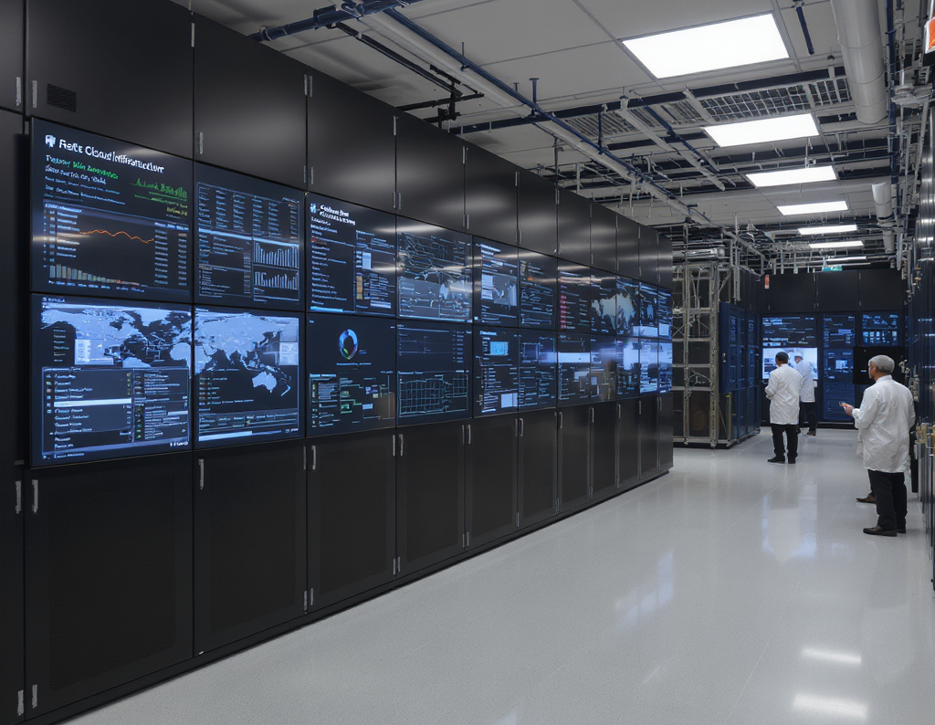

High-Level Architecture
Architecture
Control Plane (Global)
Manages tenant provisioning, authentication, billing, and service catalog through API, Keycloak/OIDC, billing systems, GitOps, and Ansible AWX for automation.
Regional PoP Clusters
Each PoP runs a Rancher-managed Kubernetes cluster hosting operators for YugabyteDB, Vitess, ScyllaDB, DragonflyDB, Aerospike, MongoDB, Kafka, and observability tools, with Anycast/GSLB ingress for client traffic.
Use the Mermaid flowchart diagram to visually complement the section headers, emphasizing the separation and interaction between the global control plane and regional PoPs.

Slide 9
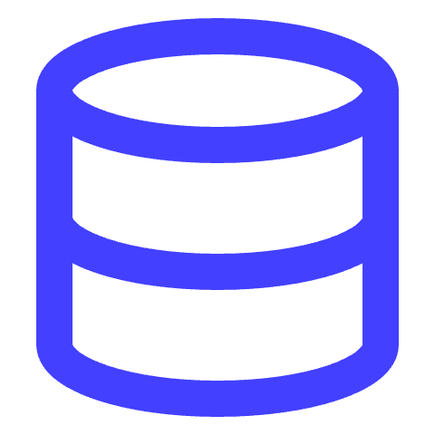

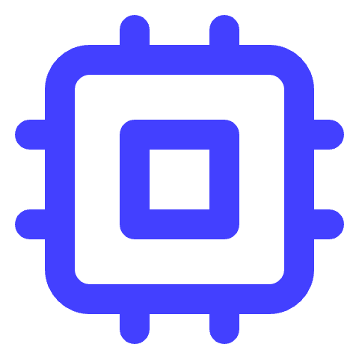
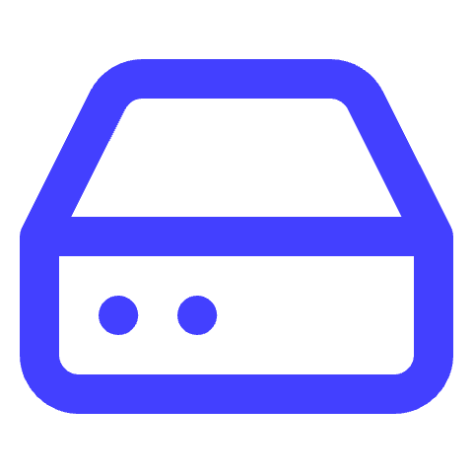


Scaling Models per Engine
Scaling
YugabyteDB: Global Distributed SQL
Vitess: MySQL Sharding
ScyllaDB: Shard-Per-Core
Supports true global tables and cross-region replication, ideal for multi-region OLTP workloads with PostgreSQL compatibility. DBaaS deploys per-tenant dedicated universes or shared with quotas.
Uses horizontal sharding with VTGate routing and supports cross-region read replicas. DBaaS automates shard templates and resharding per plan via operators.
Implements elastic ring architecture with shard-per-core for predictable low-latency performance and multi-DC replication. DBaaS assigns per-tenant keyspaces with replication factors tuned by plan.
DragonflyDB: In-Memory Speed
Aerospike: Strong Consistency
MongoDB: Replica Sets & Sharding
Provides ultra-fast Redis/Memcached compatible in-memory caching with native active-active clustering. DBaaS deploys logical DBs per tenant or dedicated nodes for high-end tiers with snapshotting.
Offers strongly consistent, high-throughput key-value/document stores with cross-DC synchronization. DBaaS provisions per-tenant namespaces with customizable storage engine types.
Uses native replica sets and sharding for scalability. DBaaS allows external orchestration and observability tools while integrating metrics and logs into the platform.

Slide 10


Kafka as Integration Glue
Integration
Use concrete examples of cross-engine event flows and Kafka connector setups to illustrate Kafka's role in your DBaaS.
CDC Patterns Supported
Kafka captures change data capture (CDC) from YugabyteDB, Vitess, MongoDB, and ScyllaDB using Debezium and native CDC sources. Aerospike connects via community and enterprise connectors, while DragonflyDB integrates through Redis Streams bridges or sidecars.
Use Cases
Kafka enables cross-engine synchronization, event sourcing, audit trails, real-time search indexing, business intelligence data lake ingestion, cache refresh, and webhook event distribution across the DBaaS platform.
Tooling & Architecture
Kafka Connect pools are deployed per Point-of-Presence (PoP) with centralized templating. Schema Registry manages Avro, JSON, and Protobuf schemas, ensuring consistent data serialization and schema evolution across services.

Slide 11
Plans & SLAs
Plans
Customize the slide by adding specific SLA targets for each plan and examples of workloads from your industry to make it more relatable.
Plan Types Overview
Comparison of DBaaS Plans by Isolation, HA/DR, Scaling, and Use Cases
Shared: Namespace and logical DB isolation with single-region HA; vertical scaling for dev/test or small apps. Dedicated: Per-tenant cluster with single-region HA plus cross-region replicas; vertical and horizontal scaling for mid-size production. Clustered: Dedicated multi-node clusters with multi-AZ fast failover; horizontal scaling via shards or rings for high TPS and low latency. Global: Dedicated multi-region active/active clusters with geo-aware scaling; designed for mission-critical worldwide applications.

Slide 12


Security & Compliance Highlights
Security
Customize the backup and audit retention policies based on your organization's compliance standards and regulatory requirements.
Network Security
Authentication & Authorization
Backups & Data Protection
Auditing & Compliance
Each tenant operates in isolated VPCs with Calico network policies enforcing strict access. Mutual TLS protects control plane services and TLS encrypts all database traffic in transit.
Keycloak with OIDC handles control plane authentication and authorization. Databases use native RBAC for fine-grained data plane access control.
Engine-native backups are stored in immutable object storage with lifecycle policies. Encryption at rest is managed by integrated KMS solutions.
Kafka maintains append-only audit logs per tenant. Logs are retained in Loki with configurable retention and vaulting policies to meet compliance requirements.

Slide 13
Global PoPs & Datacenters
Infrastructure
Africa - Lagos
Africa - Johannesburg
Europe - Key Hubs
North America - Strategic Sites
Asia & Oceania
Equinix (MDXi) and Rack Centre host this West Africa hub, offering rich MNO peering and proximity to subsea cable landing stations, making it ideal for regional connectivity.
Teraco (Digital Realty) and Africa Data Centres provide the largest internet exchange on the continent, serving as a gateway to the Southern African Development Community (SADC) region.
London (Equinix, Telehouse) and Frankfurt (Equinix, Interxion) feature major exchanges like LINX and DE-CIX, offering finance-grade latency and extensive cloud on-ramps.
Ashburn (Equinix, Digital Realty) boasts the world’s densest interconnects; Silicon Valley and Dallas offer low-latency cloud on-ramps and central US reach respectively.
Singapore (Equinix, STT GDC) supports Pan-ASEAN peering; Tokyo serves as the Northeast Asia enterprise hub; Sydney provides coverage for Australia and New Zealand.

Slide 14
Bill of Materials per PoP
Infrastructure
Use this slide to specify hardware sizing based on tenant load and expected scale for each PoP.
01
02
03
Kubernetes Control & Infra Nodes
Database Nodes
Kafka Brokers & Connect
3 nodes, dual 32-core CPUs, 128–256GB RAM, NVMe SSDs, dual 25GbE. Hosts Rancher, core controllers, ingress, and observability stack.
YugabyteDB (6), Vitess (6), ScyllaDB (6), DragonflyDB (4), Aerospike (4), MongoDB (6). Each: high-core CPUs, 128–512GB RAM, NVMe storage, 25GbE networking.
5 Kafka brokers, 24–32 cores, 128–256GB RAM, NVMe, plus 3 Zookeeper/KRaft controllers. Supports event streaming and CDC.
04
05
06
Object Storage Nodes
Ingress & Load Balancers
Observability & Management
6 nodes, 24–32 cores, 128GB RAM, 12×18TB HDD + SSD cache, dual 25GbE. Runs S3-compatible storage for backups and snapshots.
2–4 nodes, 16–24 cores, 64–128GB RAM, NVMe SSDs, 25GbE. Handles L4/L7 ingress traffic with Anycast/GSLB.
3–4 nodes for Prometheus, Grafana, Loki, Tempo, OpenTelemetry, plus 2 bastion nodes for AWX, Git, and jump hosts.

Slide 15
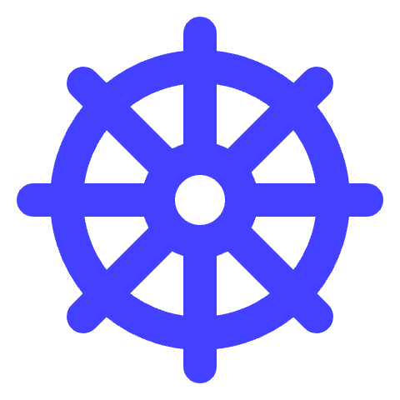
Kubernetes & Automation Choices
Automation
Customize this slide by adding specific automation playbooks or GitOps workflows relevant to your environment to demonstrate practical usage.
Rancher & Kubernetes Clusters
Operators & Helm Charts
Ansible AWX & GitOps
Deploy a centralized Rancher management cluster with dedicated workload clusters per PoP for streamlined multi-cluster RBAC and fleet management.
Use native Kubernetes Operators and Helm charts for each database engine to automate deployment, scaling, upgrades, and lifecycle management.
Automate day-2 operations with Ansible AWX for node imaging, OS hardening, and upgrades; use GitOps (Argo CD or Flux) for declarative infrastructure and application delivery.

Slide 16

Example CRD: ServiceClaim
CRD
The ServiceClaim CustomResourceDefinition (CRD) defines how tenants request database services in the DBaaS platform. It specifies engine type, plan, region, storage, HA settings, backups, and observability. This CRD allows automated provisioning and lifecycle management of tenant clusters using Kubernetes operators and Helm charts. It provides a self-service, GitOps-friendly interface for consistent, isolated, and compliant multi-tenant deployments.

Slide 17

Observability Implementation
Observability
Tailor dashboards to highlight tenant-specific SLAs and critical engine metrics for your audience.
Metrics Collection
Dashboards & Tracing
Logging & Auditing
OpenTelemetry DaemonSets gather telemetry data across all engines. Engine-specific exporters (YugabyteDB, Vitess, Scylla, Dragonfly, Aerospike, MongoDB) feed Prometheus for real-time metrics aggregation and alerting.
Grafana provides engine-specific and per-tenant dashboards organized by folders, while Tempo collects distributed traces with OTLP support for pinpointing slow queries and performance bottlenecks.
Loki stores logs long-term with retention policies and integrates with Kafka for append-only audit logs per tenant. Logs support troubleshooting, compliance, and security audits with vaulting policies for immutability.

Slide 18



Backup, Restore & DR Patterns
Disaster Recovery
Add diagrams showing backup flows and DR failover using Anycast/GSLB for enhanced visual understanding.
YugabyteDB Backups
Vitess/MySQL Backup
ScyllaDB Snapshots
Uses xCluster for asynchronous replication and scheduled table or group backups to object storage, ensuring data durability and easy recovery.
Utilizes Vitess backup hooks with xtrabackup to store consistent backups on object storage; supports replica rebuilds from these backups for quick restoration.
Employs nodetool snapshots and sstableloader for backup and restore; multi-DC replication with RF=3 provides disaster recovery across data centers.
DragonflyDB Persistence
Aerospike Backup & XDR
MongoDB Snapshots & PITR
Performs periodic snapshots and AOF-like persistence shipped to object storage, enabling warm standby setups and fast recovery after failures.
Supports asbackup/restore utilities with cross-datacenter replication (XDR) for strong consistency and disaster recovery over multiple regions.
Offers consistent snapshots and oplog point-in-time recovery (PITR); tools like mongodump/load assist with smaller dataset restores effectively.

Slide 19
Minimal Service Catalog
Service Catalog
Customize SKUs with resource sizes and replication factors based on tenant workload profiles to optimize cost and performance.
01
02
03
04
05
YugabyteDB SKUs
Vitess SKUs
ScyllaDB SKUs
Dragonfly & Aerospike SKUs
MongoDB SKU
yb-shared: 2 vCPU / 8GB RAM, shared universe for single-region dev/test. yb-global: 8–32 vCPU / 32–128GB RAM, designed for x-region active/active global tables.
vt-sharded: per-shard 4–16 vCPU, supports automatic VTGate routing and MySQL sharding, ideal for scalable distributed OLTP.
scy-ring: 3+ nodes with 8–32 vCPU each, RF=3 replication, DC-aware for multi-DC resilience and high throughput workloads.
dfly-mem: 16–64GB RAM, clustered with snapshot support for in-memory cache/store. aero-strong: 3–5 nodes, strong consistency and cross-DC sync for high TPS KV workloads.
mongo-flex: replica set or sharded configurations, external ops tools supported, flexible for various workload sizes and monitoring integrations.

Slide 20
Practical Rollout Order
Rollout
Customize the rollout steps based on your data center's specific hardware and network environment to optimize deployment efficiency.
01
02
03
04
05
06
Rack & Network Setup
AWX Imaging & Bootstrap
Deploy Core Infra
Deploy Kafka & Connect
Deploy DB Operators
Backup & Tenant Onboard
Deploy racks, establish network fabric using EVPN/VXLAN, configure out-of-band management to ensure physical and network readiness.
Use Ansible AWX to image nodes, apply OS hardening, bootstrap Kubernetes cluster (RKE2 or kubeadm), and join the cluster to Rancher management.
Install core services including cert-manager, CSI drivers, ingress controllers, and monitoring stack components like Prometheus, Loki, Tempo, and Grafana.
Set up Kafka brokers, Kafka Connect pools, and Schema Registry with centralized configuration to enable event streaming and CDC pipelines.
Deploy database operators and small footprint clusters for each engine; validate service-level objectives and ensure readiness for tenant workloads.
Wire up object storage for backups, configure KMS and SIEM integrations, expose DBaaS API and Portal, and onboard initial tenants with ServiceClaim CRDs.
Racks installed Network fabric configured (EVPN/VXLAN) Out-of-band management operational
Nodes imaged with OS Kubernetes cluster bootstrapped Nodes joined to Rancher cluster
cert-manager deployed CSI drivers installed Ingress controller active Observability stack running
Kafka cluster operational Kafka Connect pools deployed Schema Registry configured
Operators for Yugabyte, Vitess, Scylla, Dragonfly, Aerospike, MongoDB deployed Test clusters running SLOs validated
Backup targets configured KMS and SIEM integrated DBaaS API and Portal live First tenants onboarded

Slide 21

GitLab Duo Super-Prompt
Automation
Automates scaffolding of a monorepo with manifests, Helm charts, GitOps, and AWX jobs for DBaaS deployment. Supports multi-engine databases: YugabyteDB, Vitess, ScyllaDB, DragonflyDB, Aerospike, MongoDB, and Kafka integration. Includes CI/CD pipeline for validation, packaging, and deployment across multiple PoPs with Argo CD integration. Generates starter Helm values with secure defaults and customizable settings for each engine and infrastructure component. Provides example ServiceClaim CRDs and tenant specs for seamless tenant provisioning and plan management.

Slide 22
Repository Layout & Key Components
Repository
Manifests Directory
Helm Charts
GitOps Applications
AWX & Kafka
Contains Kubernetes CRDs, base resources like namespaces and RBAC, operators for each database engine, observability components, and backup policies.
Holds parameterized Helm values for each database engine and core services such as ingress, Kafka, and observability stack to enable flexible deployments.
Argo CD Applications organized by PoPs and base components, including operator sets and tenant controllers for declarative environment management.
AWX playbooks automate day-2 operations like OS hardening and upgrades; Kafka connectors enable CDC integration across engines with example configs.

Slide 23
Helm Values & Configurations
Configurations
Highlight key Helm value parameters for your audience’s top-used engines to make the slide more relevant.
01
02
03
Engine Helm Values
Core Service Configurations
Customization & Extensibility
Each engine has tailored Helm charts with starter values: YugabyteDB with RF=3 & TLS; Vitess with keyspace & shards; ScyllaDB tuned for shard-per-core; DragonflyDB with snapshots; Aerospike with rack-aware XDR; MongoDB supports external tooling.
Core Helm charts include Kafka brokers with KRaft mode, Connect, Schema Registry; NGINX Ingress for L4/L7 traffic; Observability stack with Prometheus, Grafana, Loki, Tempo, and OpenTelemetry exporters.
Values are commented for tuning CPU, memory, storage, HA, backups, TLS, and observability. Supports overrides for scaling and environment-specific needs via Helm’s values hierarchy.

Slide 24
GitOps Argo CD Applications
GitOps
Customize the slide by adding specific examples of Argo CD application manifests or overlays for your target PoPs.
Per-PoP Argo CD Application Composition
GitOps Benefits and Workflow
Base infrastructure apps manage namespaces, RBAC, storage classes, and ingress setup. Operator apps deploy database engines (YugabyteDB, Vitess, ScyllaDB, Aerospike, MongoDB, Dragonfly) using Helm charts and operators. Observability apps include Prometheus, Grafana, Loki, Tempo, and OpenTelemetry collectors for monitoring and tracing. Kafka apps deploy broker clusters, Connect, and Schema Registry for event streaming and CDC integration. Tenant apps are generated from ServiceClaim CRDs, rendering per-tenant HelmRelease or Argo Application manifests.
Declarative deployment ensures consistent, repeatable cluster state across PoPs. Per-region customization via overlays enables environment-specific configurations. Automated sync and health checks maintain up-to-date deployments without manual intervention. Integration with CI/CD pipelines allows seamless promotion from staging to production. Scalable multi-tenant management using Git repos as the single source of truth.

Slide 25
AWX Playbooks & Inventories
Automation
Customize playbook examples with your specific cluster details and expand inventories as you add more PoPs.
01
02
AWX Playbooks Overview
Inventories & Usage
Bootstrap Kubernetes clusters: OS hardening, container runtime setup, kubeadm/RKE2 bootstrap, join Rancher management. Tune ScyllaDB nodes: irqbalance, hugepages, NUMA settings, IO scheduler, and kernel parameters for optimal performance. Upgrade operators and managed engines with rolling update strategies ensuring minimal downtime. Configure and verify per-engine backup processes to object storage with restore validation. All playbooks are idempotent and reusable across PoPs for consistent operations.
Inventories define host groups like control, workers, and storage nodes per PoP (e.g., lagos.ini, johannesburg.ini). Separate inventories enable tailored automation for each datacenter or region cluster. AWX integrates with Kubernetes clusters for smooth day-2 operations and upgrades. Playbooks leverage inventories to target specific nodes for operations, upgrades, and backups. Documentation and role-based access help maintain clear operational procedures.

Slide 26
Kafka Connectors & Sidecar Patterns
Integration
Customize by adding specific connector configuration examples or sidecar implementation details relevant to your deployment.
Kafka Connector Examples
Redis/Dragonfly Sidecar Pattern
Debezium connectors for YugabyteDB (Postgres), Vitess (MySQL), and MongoDB enable CDC with change event streaming. Scylla CDC Source connector captures Cassandra-compatible change data for real-time sync. Aerospike connector integrates Aerospike KV/Doc changes into Kafka topics for downstream processing. Kafka Connect pools are centrally templated per PoP for consistency and scalability. Schema Registry supports Avro, JSON, and Protobuf schemas for data validation and compatibility.
Lightweight sidecar tails Redis protocol keys/events to produce Kafka Streams for CDC. Periodic snapshot events enrich stream data reliability and recovery. Bridges Redis Streams to Kafka, enabling cross-engine event pipelines with Redis-compatible caches. Sidecar allows asynchronous fan-out and audit trail creation from in-memory DB changes. Facilitates integration of ultra-fast DragonflyDB with Kafka-based analytics and BI pipelines.

Slide 27
CI/CD Pipeline Overview
CI/CD
Customize this slide by adding your own CI/CD toolchain details or specific pipeline steps relevant to your organization’s deployment process.
Validate
Build & Package
Deploy
Promote & Release
Run Kubernetes manifest validation (kubeval/kubeconform), Helm linting, and YAML linting to ensure manifests and charts are syntactically correct and compliant before deployment.
Build container images for helper tools like tenant controllers, then render Helm and Kustomize templates for each PoP environment, producing deployable artifacts for CI stages.
Apply manifests and Helm releases to the target Kubernetes clusters using environment-specific kubeconfigs and Argo CD or kubectl, enabling automated rollout to each PoP.
Tag releases in Git, update Helm chart versions, and promote stable builds to production branches, ensuring traceability and consistent versioning across environments.
Validated Kubernetes manifests Helm chart lint reports YAML linting results
Container images for custom controllers Rendered manifests per PoP Packaged Helm charts
Deployed Argo CD Applications Kubernetes resources applied Environment-aware deployment logs
Git tags for releases Updated Helm appVersion Release notes and changelogs

Slide 28
Example Tenant Specs
Tenancy
01
02
03
YugabyteDB Tenant Spec
Vitess Tenant Spec
MongoDB Tenant Spec
Tenant123 requests a clustered YugabyteDB with 2Ti storage, RF=3, cross-region replicas in Johannesburg and Frankfurt, backups every 6 hours, and enabled observability for metrics and logs.
Example tenant requests a dedicated Vitess plan with sharded MySQL, region set to Lagos, backup retention of 14 days, and observability enabled for scraping metrics.
Tenant uses MongoDB with a shared replica set plan, located in Singapore, with scheduled backups, PITR enabled, and external monitoring tools integrated.

Slide 29
Documentation & Default Settings
Documentation
Tailor the documentation section with links or references to your internal wiki or knowledge base for easy access by your operations and engineering teams.
01
02
03
Key Documentation
Security & Compliance Docs
Defaults & Configurations
Includes architecture overviews, global PoP selections, security best practices, and operational runbooks for tenant onboarding and PoP expansion.
Detailed guides on TLS everywhere, KMS-managed keys, per-tenant network isolation, RBAC, and audit logging with Kafka-backed append-only topics.
Standardized defaults for TLS (self-signed via cert-manager), StorageClasses (fast NVMe, bulk HDD), and ingress hosts using REGION.dbaas.EXAMPLE_DOMAIN variables for consistency.

Slide 30
Thank you

Slide 31
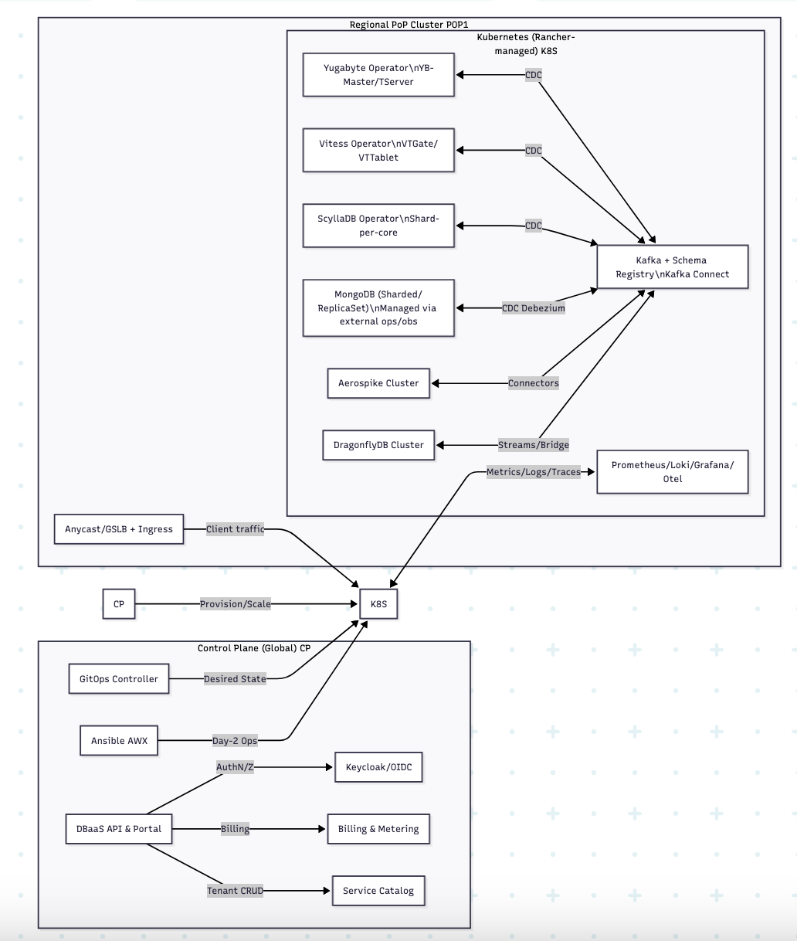
High-level architecture

